Slide 1
Blue Economy
in Barbados
By Samiksha Khare
Master’s in Information Systems,
Santa Clara University

Slide 2
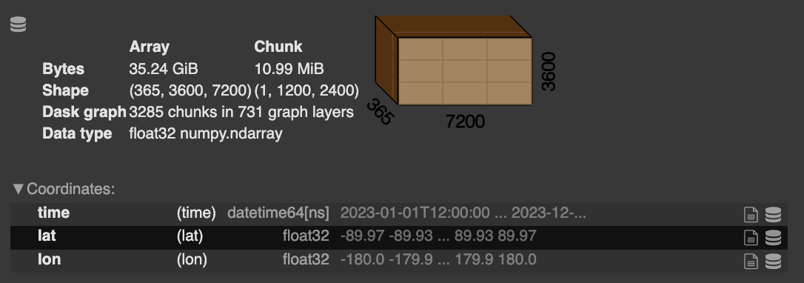
SST Dataset Overview
File format: NetCDF (Network Common Data Form)
Shape: (365, 3600, 7200) → time × lat × lon
Time dimension: 365 days of a year
Spatial resolution: 0.05° × 0.05° (~5–6 km)
Coverage: Global (−90° to +90° lat, −180° to +180° lon)
Variable: analysed_sst = Sea Surface Temperature (SST)
Data type: float32 (~35.24 GiB)
Ref: data.marine.copernicus

Slide 3
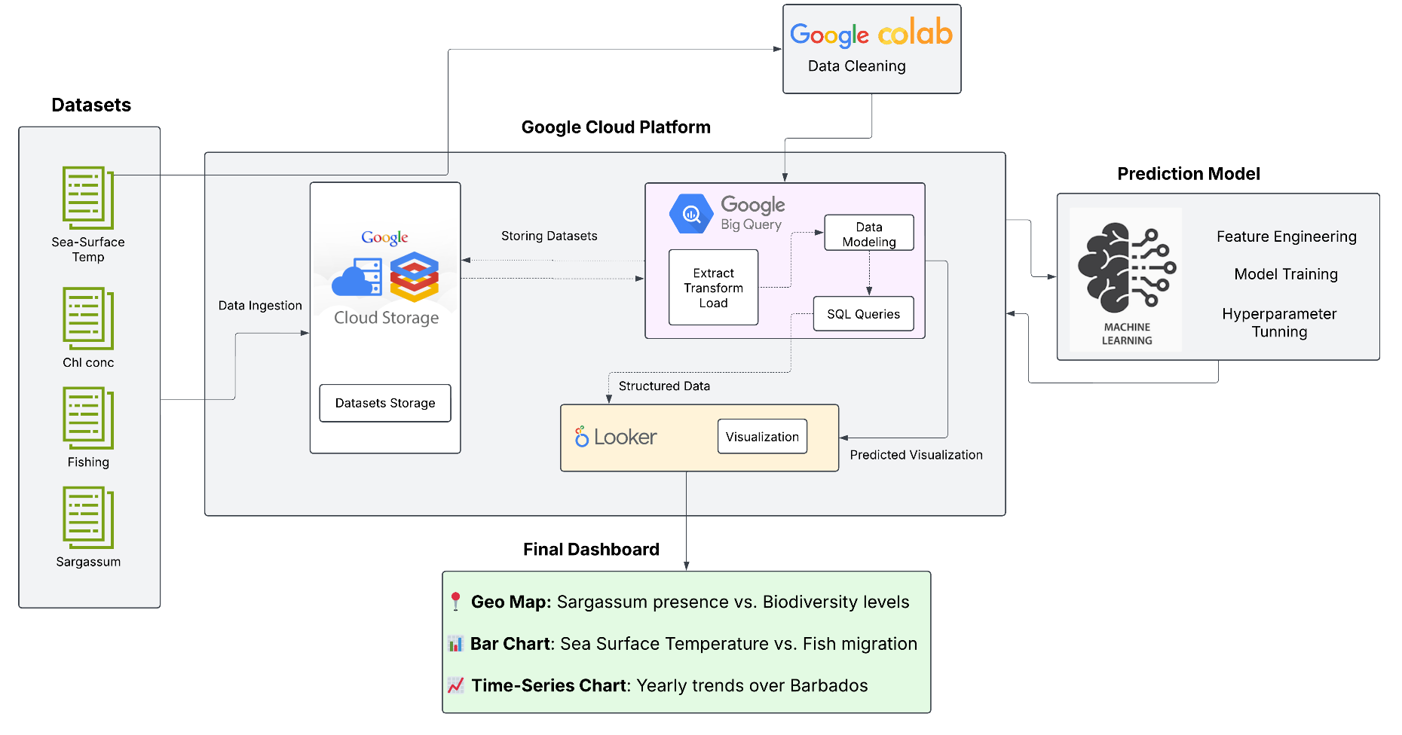
Architecture
Ref: lucid.app

Slide 4
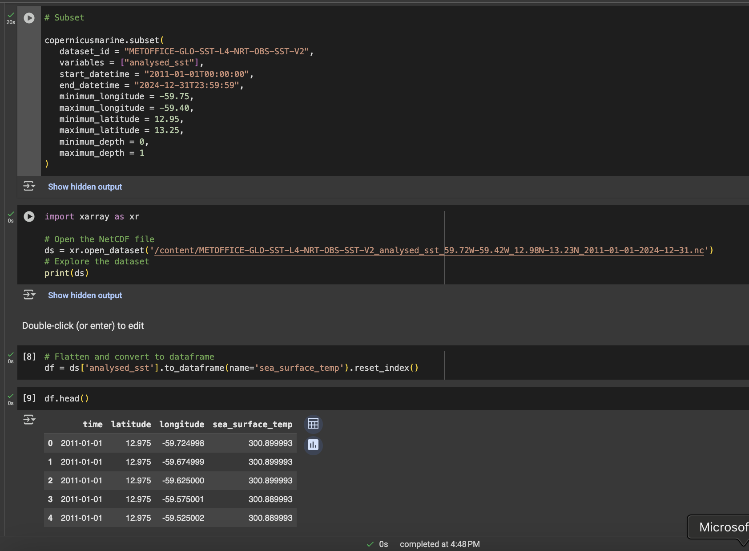
Data Cleaning in Google Colab

Slide 5
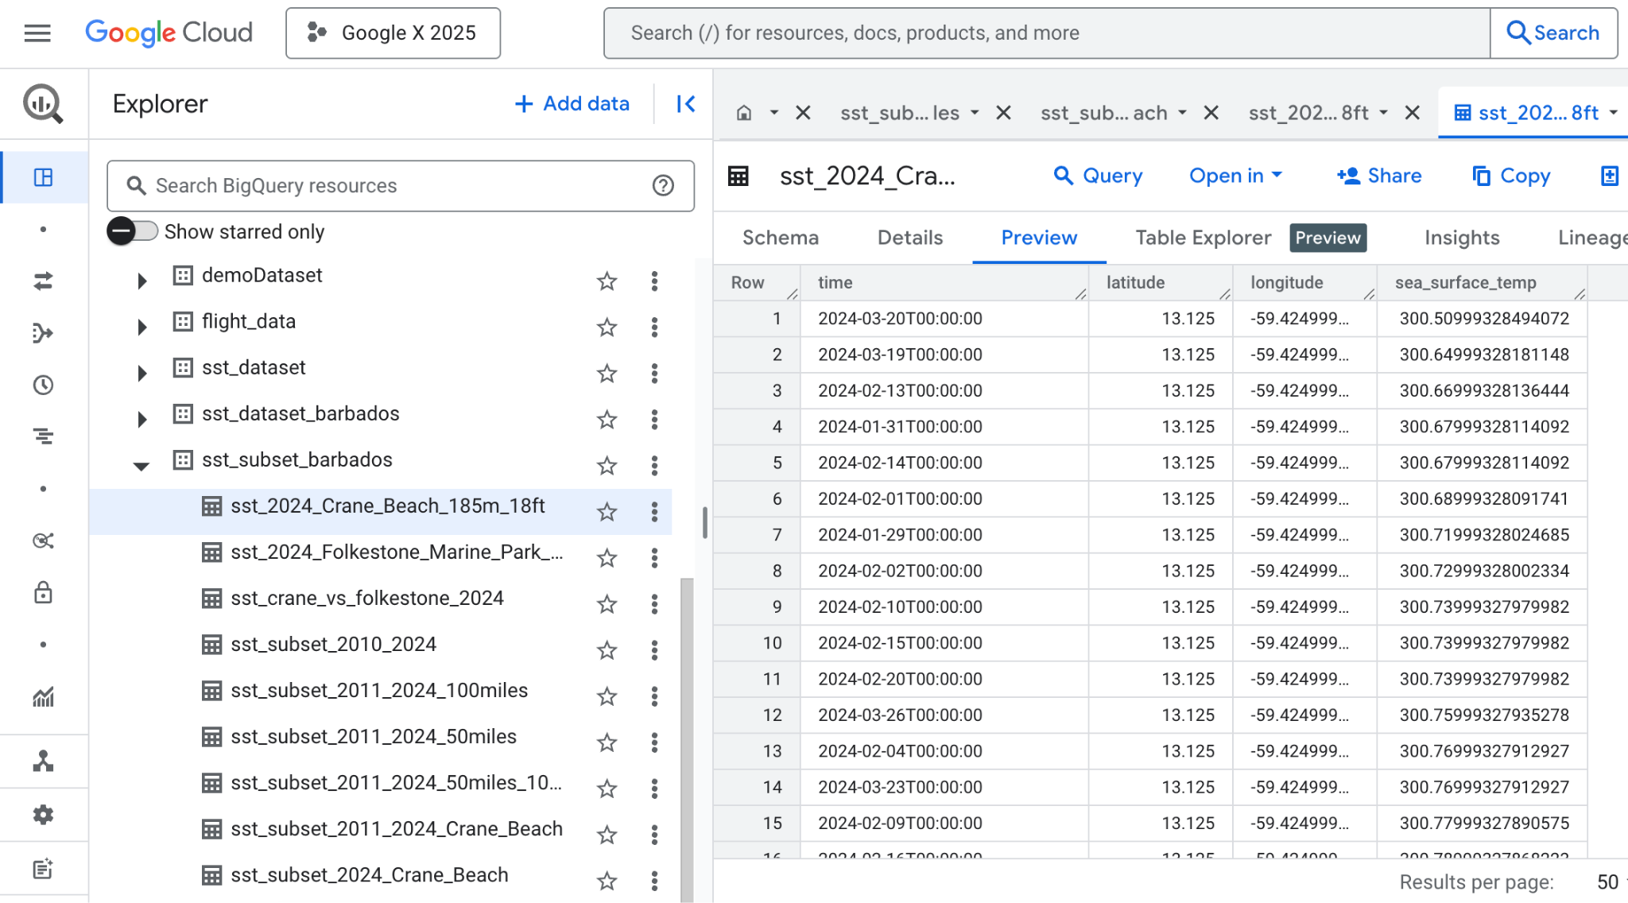
SST Dataset in BigQuery

Slide 6
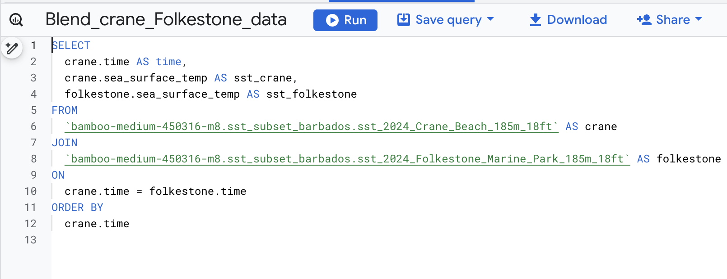
Querying in BigQuery
Notes:
1 year data 32 gb
Excrated 10+ years data through API specific to barbados

Slide 7
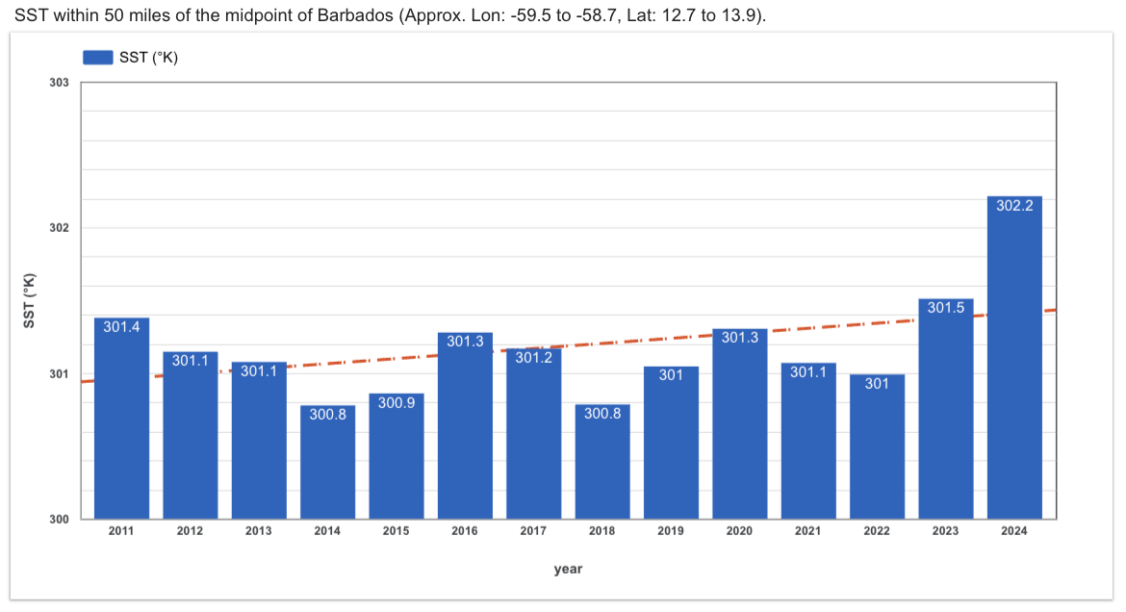
Sea Surface Temperature Trends in Barbados (2011–2024)
Since 2011, SST has risen by 0.8 K (equivalent to +0.8°C), reflecting a steady warming trend in the region.

Slide 8
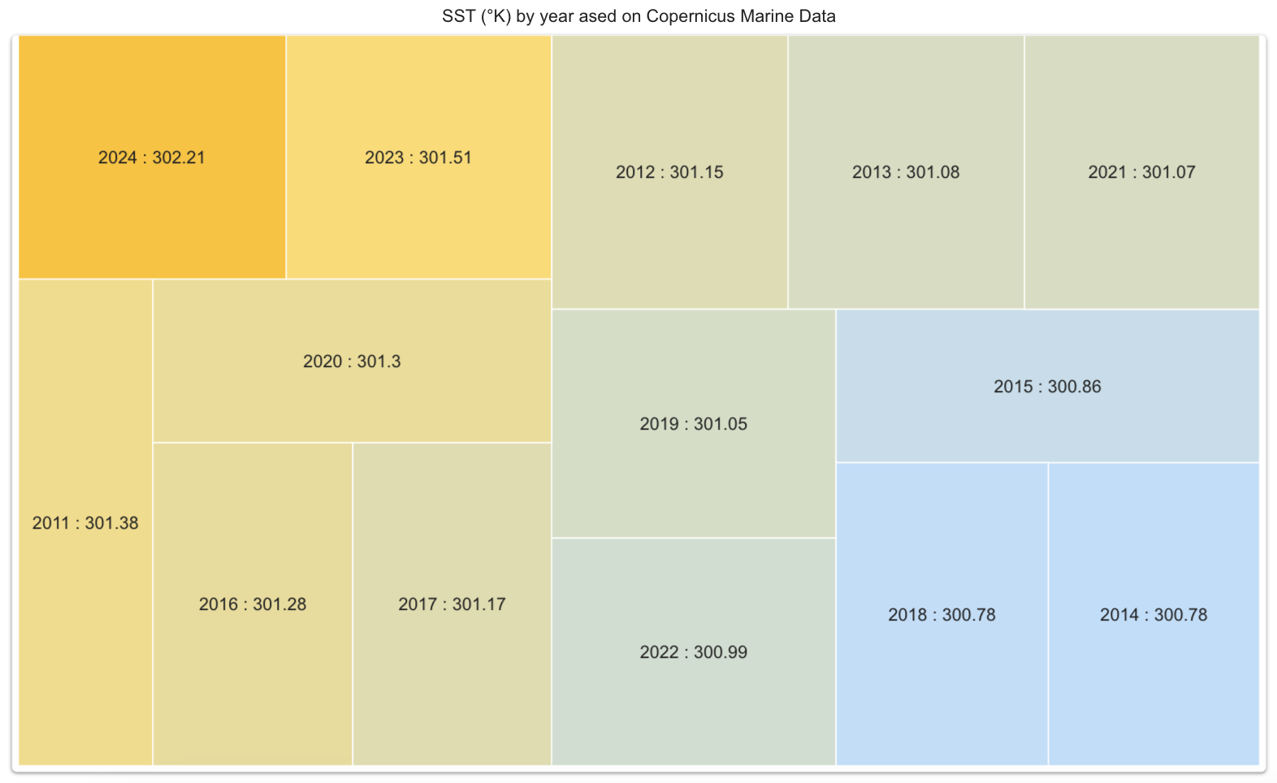
Year-wise Heat Distribution of SST Around Barbados

Slide 9
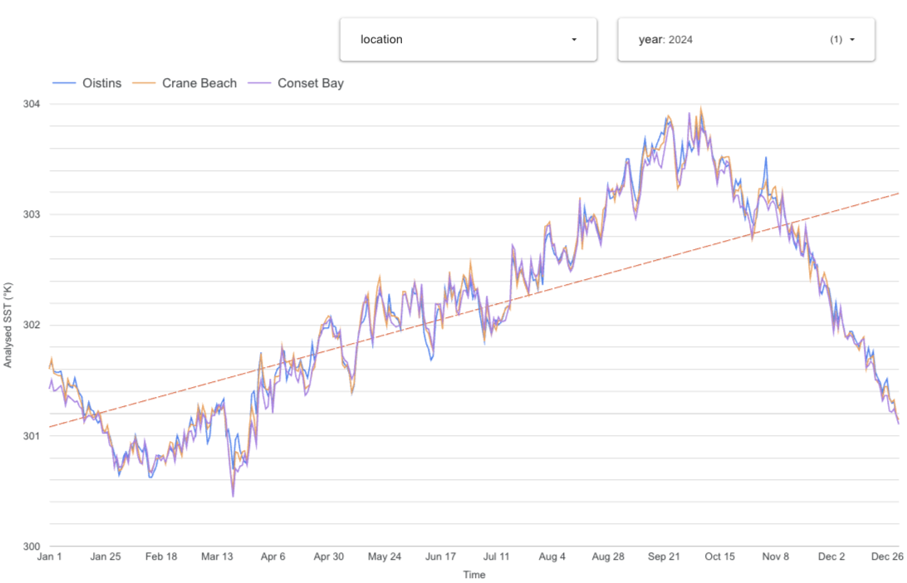
Daily SST Trends Across Barbados Coastal Sites
Sea surface temperature trends across Barbados coastal sites show minimal variation, indicating consistent thermal conditions across locations.

Slide 10
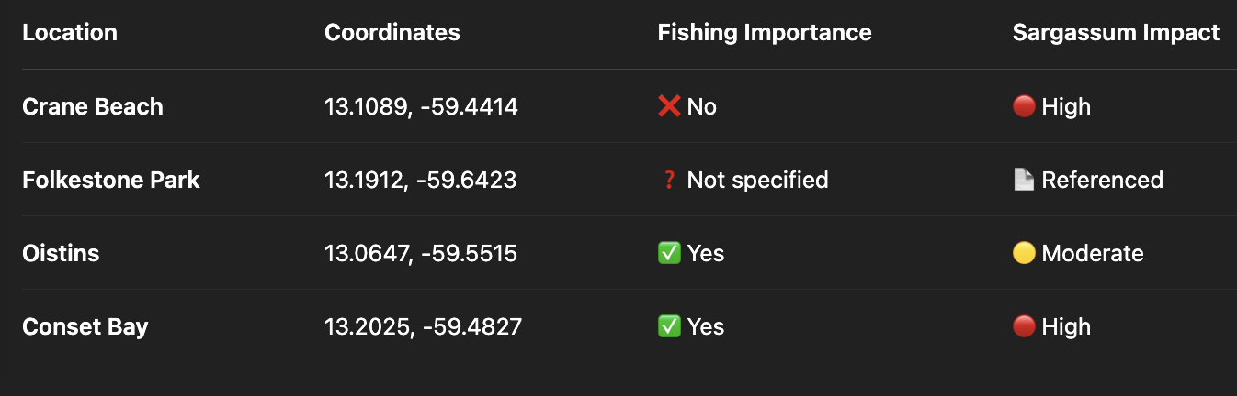
Geographic Coverage & Coastal Site Overview
Ref: barbados sargassum adaptive management strategy (sams)v.2.pdf

Slide 11
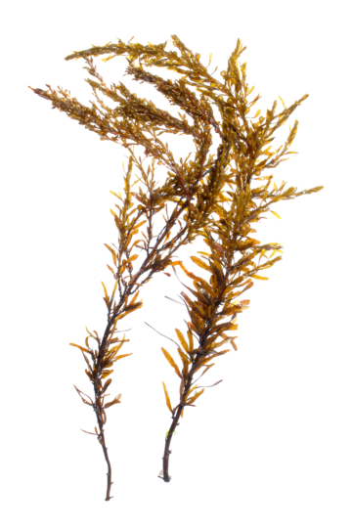
Sargassum Impact

Slide 12
Copernicus Marine Data to Analyze Sargassum
Purpose
To investigate how changes in Net Primary Productivity (NPP) influence the presence or absence of Sargassum landfall events near Crane Beach, Barbados.
Dataset Source: Copernicus Marine Service – GLOBAL_MULTIYEAR_BGC_001_033 Dataset ID: cmems_mod_glo_bgc_my_0.083deg-lmtl_PT1D-i
Study Area & Time Frame:
Region: Offshore waters ~3 miles east of Crane Beach, Barbados Depth: Surface layer (0–5 meters), ideal for floating Sargassum analysis
Period: Daily data from 2011 to 2024
Reference: data.marine.copernicus

Slide 13
What is NPP ?
Variable | Why It Matters for Sargassum
Net Primary Productivity (NPP) (gC/m²/day) | Measures the rate at which carbon is fixed by phytoplankton through photosynthesis. High NPP indicates favorable conditions for algal growth, often aligned with Sargassum bloom development.
Euphotic Zone Depth (ZEU) | Represents the depth sunlight penetrates in the ocean. Greater depth allows more light for photosynthesis, supporting Sargassum proliferation.
Zooplankton & Micronekton Biomass | Reflects changes in the marine food web. While not directly linked to Sargassum, it helps assess ecosystem response during and after bloom events.

Slide 14
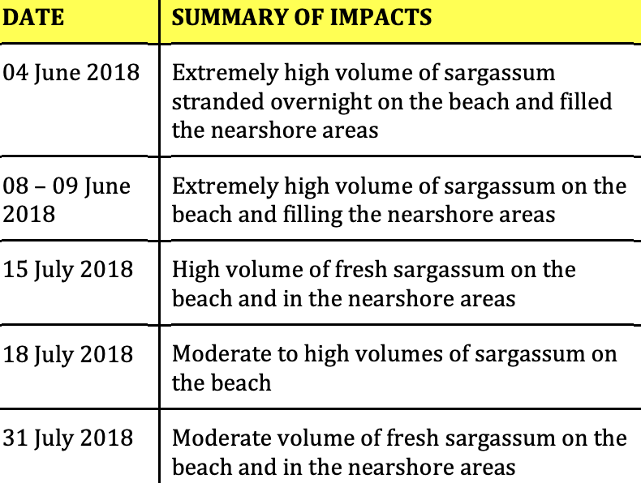
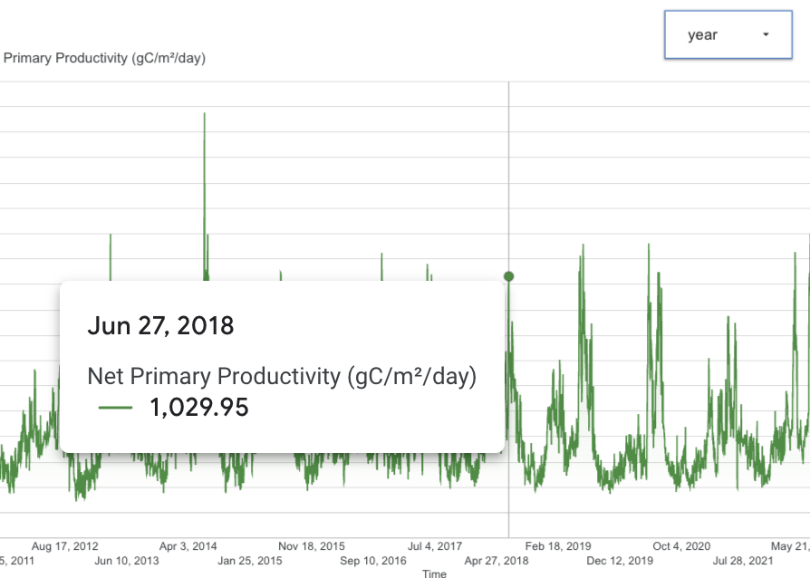
Sargassum Bloom Linked to Offshore Productivity
A sharp NPP spike on June 27, 2018, aligned with extreme Sargassum at Crane Beach.
Highlights a potential link between offshore ocean productivity and coastal Sargassum accumulation.
Ref: SAMS

Slide 15
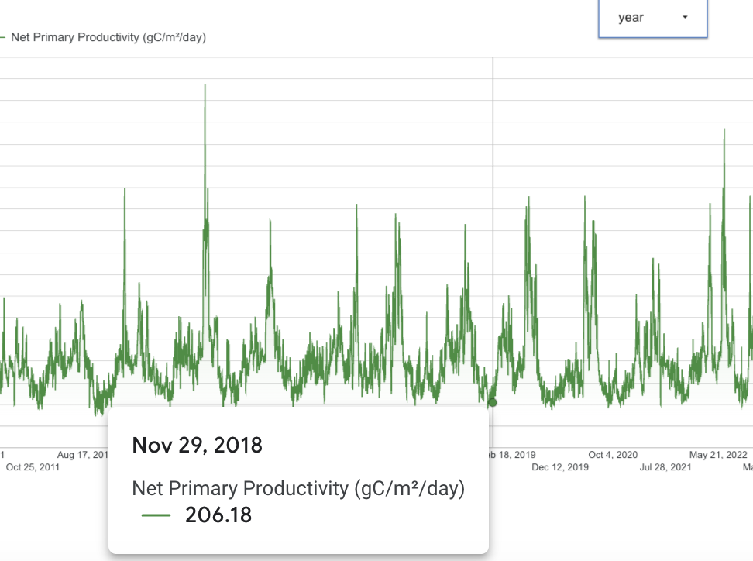
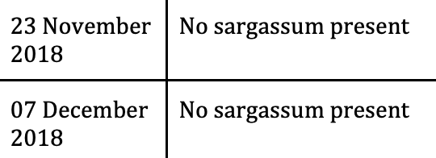
Sargassum Bloom Linked to Offshore Productivity
Net Primary Productivity remained low (~252 gC/m²/day) on Nov 30, 2018.
No Sargassum was observed during this period, indicating unfavourable bloom conditions.
Ref: SAMS
Dashboard

Slide 16



How This Insight Helps Fishermen in Barbados?
We found that Sargassum is more likely to appear from May to July
Predicts peak Sargassum season
Improves catch strategy
Reduces equipment damage
Fishermen can plan around bloom periods like high-yield trips before Sargassum hits
Since fish often avoid heavy Sargassum areas, this insight helps fishermen choose better fishing locations and timing.
Knowing when Sargassum is coming helps them service engines early and avoid clogged propellers, damaged gear or tangled fishing nets
Ref: sargassum_in_summer, catch_strategy

Slide 17
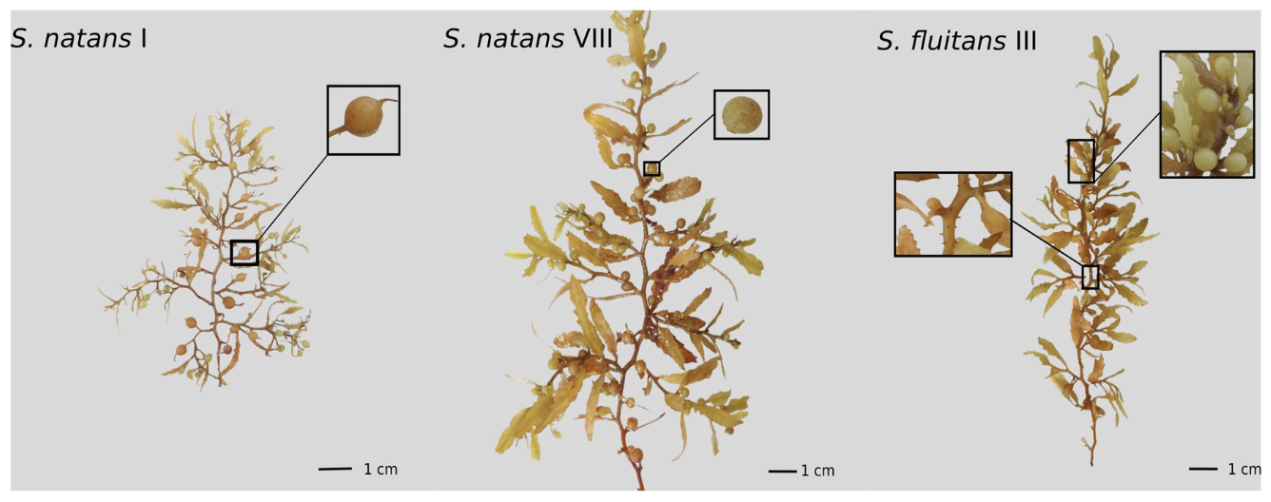
Reference: General appearance of the three pelagic Sargassum morphotypes

Slide 18
Thank you
Happy to take any questions
Dashboard

